Slide 1
Bank Reserves
Bank Reserves are an important thing to understand in Unit 4.
We will soon see that have a significant effect on money supply.

Slide 2

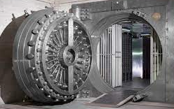


Required Reserves
Your Deposits
Summary
Required reserves = must be kept
RRR = required reserve ratio (percentage that must be kept)
Excess Reserves – up to the bank if they want to keep them
Required Reserves is the amount that banks are required by law (set by the Federal Reserve) to keep in reserve.
  This prevents banks from lending out too much of the deposits, so that if customers wish to withdraw money they have enough.
  This money is actually kept in the Central Bank’s vaults (nowadays increasingly electronic in nature)
The bank can choose to keep excess reserves if they choose. This is not mandatory.
Total Reserves
Free to be lent out etc.
The Fed ensures enough reserves are kept. The required reserves are actually stored in the Fed’s own vaults.
Required Reserves
Excess Reserves
Bank can choose to keep these
The Fed

Slide 3
Your Deposits
Total Reserves
Free to be lent out etc.
The Fed ensures enough reserves are kept. The required reserves are actually stored in the Fed’s own vaults.
Required Reserves
Excess Reserves
In the future, the bank can use the excess reserves for lending.
The Fed
Bank can choose to keep these

Slide 4
Required Reserves and the Required Reserve Ratio
Required Reserve Ratio (RRR)
= Required Reserves / Total Deposits x 100%
Example: $1 million required reserves, $10 million total deposits, RRR = $1 million / $10 million x 100 = 10%
Total Reserves
Eg. A bank has $10 million in deposits and keeps $2 million in reserve
The required reserve ratio (RRR) is the percentage of total deposits that the bank must hold in reserve.
Required Reserves
Set by the Federal Reserve and is mandatory for all banks to follow.
Excess Reserves
Up to the discretion of the individual bank
$1 million
The bank may be cautious and not want to buy assets or loan out an additional amount.
Summary
Required Reserves – mandatory, set by the RRR
Excess Reserves – extra reserves that the bank may choose to keep
RRR = Required Reserves / Total Deposits x 100%
Eg. RRR = 10% and $10 million deposits. Therefore, $1 million

Slide 5
What is the difference between required reserves and excess reserves?
Required reserves are what the bank must keep in reserve.
Excess reserves is what banks can choose to keep as extra.
If a bank has a total of $1 million in deposits and the RRR is 15% (0.15), then how much must the bank keep in required reserves?
= $1 million x 0.15 = $150,000
Is this the maximum amount of reserves that the bank can keep?
No, they can keep excess reserves if they wish.
If a bank has $1 million in Required Reserves and $5 million in total deposits, what is the rr?
rr = 1 / 5 = 20%

Slide 6
400 Macro Questions
Answer: D
16. What are bank reserves?
  Deposits that are held in the form of gold reserves
  The sum of all loans a bank makes to borrowers
  The value of investments a bank keeps in excess of the value of deposits
  The fraction of deposits kept as currency or on deposit at the Federal Reserve
  The value of owner’s equity in the bank

Slide 7
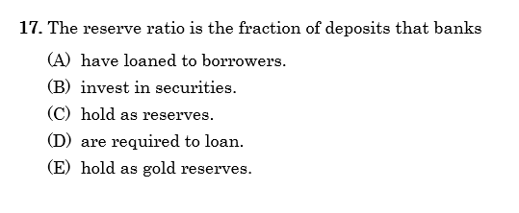
400 Macro Questions
Answer: C

Slide 8

Fractional Reserve Banking
Summary
Banks keep a fraction of reserves and lend the rest out.
$100
We can see that when each bank receives a certain amount of money, it has to keep a fraction in reserve as required reserves.
The rest it can lend out.
This is the essence of the fractional reserve banking system.
Can lend out
$90
$10
Must keep in reserve
Can lend out
$81
$9
Must keep in reserve
Can lend out
$8.1
$72.9
Must keep in reserve
Revision: Where can the banks get money from loans?
Answer: Excess Reserves.
This is money that is not being used that can be used for loans.
Can lend out
$65.6
$7.3
Must keep in reserve
Etc.

Slide 9
What defines the fractional reserve banking system?
The fact that banks must keep a certain percentage of deposits as reserves and then can lend the rest out.

Slide 10
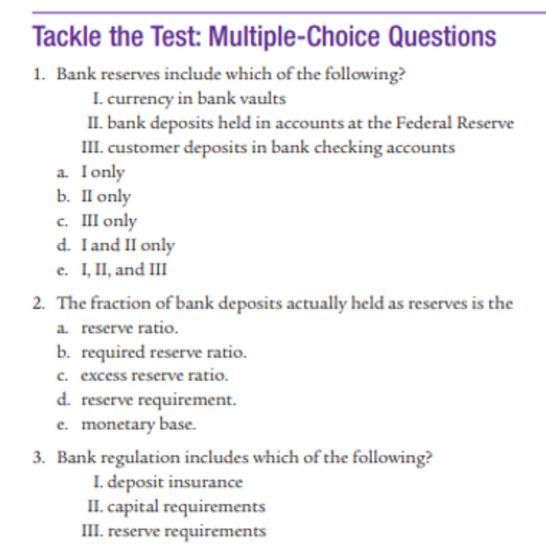
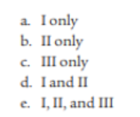
Mod 25
1. d
  I = excess reserves
  II = required reserves
2. a
  (Note: the required reserve ratio is what we usually care about in the AP syllabus, but not for this question)
3. e
  These options all ensure the safety and stability of banks.

Slide 11
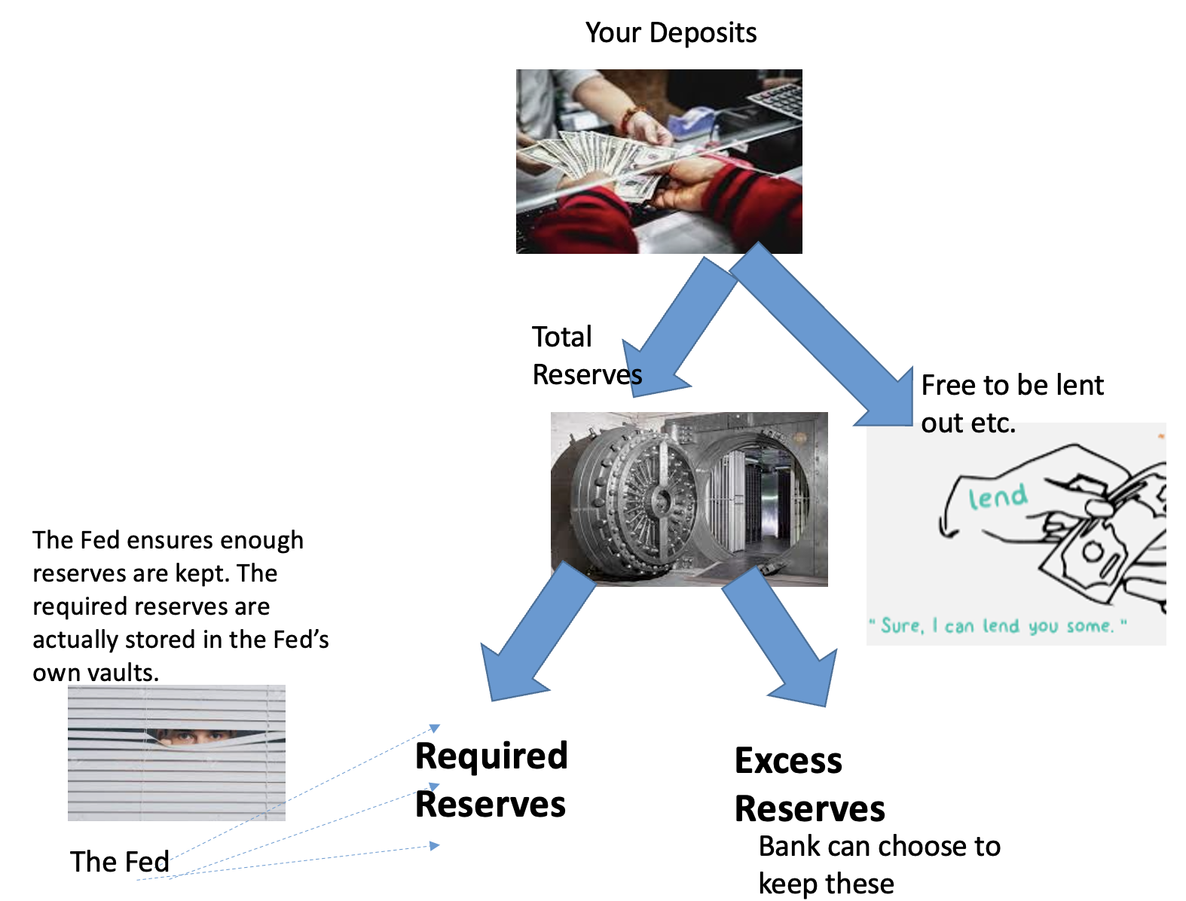
Summary - Reserves
Equations
Total Reserves = Required Reserves + Excess Reserves
Required Reserves = Reserve Requirement (rr) x Deposits
∴ Reserve Requirement (rr) = Required Reserves / Deposits
Total Reserves = Required Reserves + Excess Reserves
  Required Reserves - banks must keep this amount and this will be kept in the Federal Reserve vaults.
  Excess Reserves – these are kept above the required reserves. It is the money that is most available for the bank to use.
Required Reserve Ratio (RRR) or Reserve Requirement (rr) = Required Reserves / Deposits
In the future, the bank can use the excess reserves for lending.

Slide 12
Assets, Liabilities and Equity
Understanding the assets, liabilities and equity will help us with the next topics; T Accounts and the Money Multiplier

Slide 13



  Unit 5 – Financial Information and Decisions
  Chapter 22 – Balance Sheets
Assets: resources that are owned by a business that have a positive value.
Liabilities: things that have a negative value, usually relating to debt or money owed.
Equity: difference between assets and liabilities. It represents the total value of the business.
All businesses, including banks, can put what they have into three categories.

Slide 14
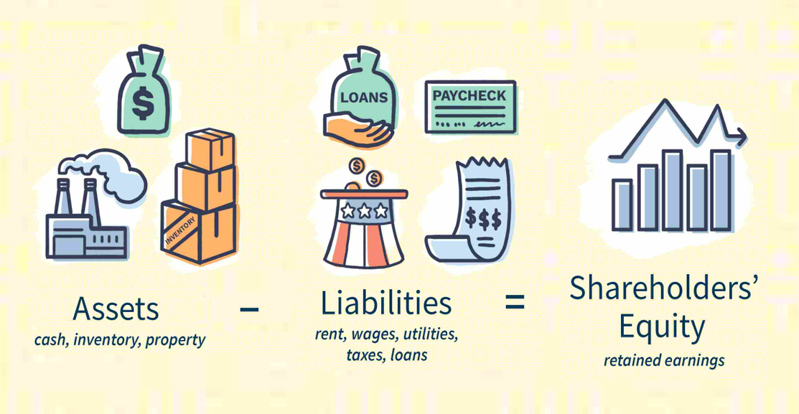
The Accounting Formula

Slide 15






Equity
Assets, Liabilities, Equity
-
Equity = Assets – Liabilities
When you take the assets (good things in the business) minus liabilities (bad things in the business), what is left over is the equity.
The bigger the equity, the better. This means the business has far more good things (assets) than bad things (liabilities).
=
Liabilities
Assets
Equity
Note: When you buy a share in a company, you are said to own a piece of the equity of the business. It is therefore sometimes called Shareholder’s Equity – the value of the business from the owner’s perspective.
Summary
Equity = assets – liabilities
The value of the company.
Businesses want it to be as big as possible!
(When you buy a stock/share it means you are a part owner of the equity of the company.)

Slide 16
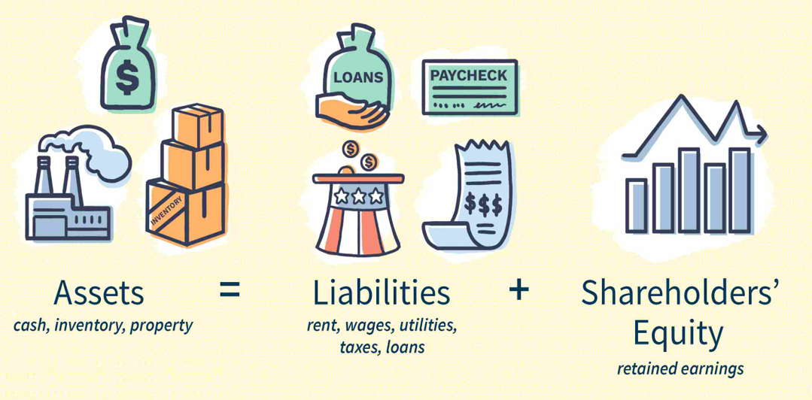
Rearranged Accounting Formula
Therefore,

Slide 17
In this course we will typically assume that Equity = 0, just to simplify the questions!
Note: In the real world businesses are trying to always increase their equity.

Slide 18
If a bank owned by shareholders has $1200 in assets and $1000 in liabilities, what do the shareholders own in total?
The equity of the bank is assets – liabilities = 1200 – 1000 = $200.
The equity is also often called shareholder’s equity.
In this course, what can we typically assume about the equity of a bank? Is this accurate?
= 0
It is not accurate, businesses are always trying to increase their equity!

Slide 19
Another Way to Think of the Accounting Equation – Assets are borrowed or owned
Assets must ‘come from’ borrowing or ownership
When you have an asset such as money, a house, a car, a copyright, gold etc., the accounting equation can tell us where you got this asset!
  Some assets are borrowed (liability)
  Some assets are yours (equity)
Eg. A business has $1 million in the bank (Asset = $1 million)
  This could be borrowed (therefore liability = $1 million)
  Or it could belong to the company (equity = $1 million)
Summary
One way of thinking about the accounting equation (Assets = Liabilities + Equity) is that assets either come from borrowing (liability) or true ownership (equity).

Slide 20
If a business has a huge amount of assets, is this business always a successful business?
No, because it may have borrowed a lot and therefore have a lot of liabilities so the equity (= assets – liablities) may be small.
It is said that Donald Trump once said in the 1990s: “That homewless person there is worth $8 billion dollars more than me.” What does this quote mean in terms of assets, liablities and equity?
Donald Trump had so many liabilities (because he owed so much money for his businesses) that his equity was actually negative $8 billion.

Slide 21
Balance Sheets
We will look at a particular type of question that combines economics and accounting – so called ‘T Account’ questions, named after the shape of the table that is used.

Slide 22

Balance Sheets / T Accounts for Banks
No. 2 Bank – T Account
Assets |  | Liabilities
Loans | $900,000 | Deposits | $1,000,000
Reserves | $100,000
 |  | Equity
 |  | 0
We can put Assets and Liabilities in a table called a balance sheet (sometimes called a T Account) as shown on the right.
They represent how banks look at the money that they hold and use as assets and liabilities.
This balance sheet can help us to solve certain questions.
Summary
Assets and Liabilities can be put into a ‘balance sheet’ or ‘T account’.
We know banks take savings and lend them out to businesses, government and households. But how are these activities recorded in their accounts?

Slide 23
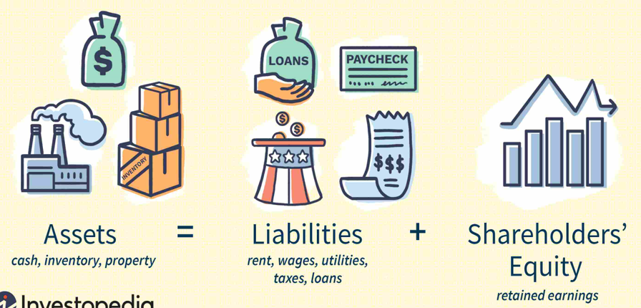
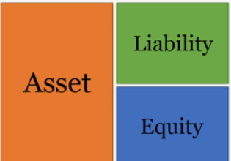
These are all different ways of representing the assets, liabilities and equity of a company.
Assets |  | Liabilities
Loans | $900,000 | Deposits | $1,000,000
Reserves | $100,000
 |  | Equity
 |  | 0
Note: It doesn’t matter if the assets are on the left or right of the T Account.

Slide 24

Bank T Accounts
Summary
The T account has assets on one side and liabilities on the other.
Assets – things that will give money in the future
Liabilities – things that will take away money in the future.
We have established that businesses have: Assets = Liabilities + Equity
And that the accounting equation can be represented in a ‘T Account’ which details the two sides of the equation.
  Assets on one side
  Liabilities (and equity) on the other
Note: Because AP Macro is not an accounting course, we will rarely if ever, have equity on our T accounts. If we did it would be on the side of Liabilities (because of the accounting equation).
Because of this, in AP Macro we can really think of the accounting equation as: Assets = Liabilities
Liabilities
Liabilities represent things that will lead to negative money flow in the future, and are mostly things that are owed (eg. money borrowed that you must pay back)
Assets
Assets are:
Things that will bring money in the future or are owned (eg. you lend money and it will be paid back)
Things that can be sold for money (eg. equipment)
Actual money (eg. cash in a bank account)

Slide 25
Bank Assets and Liabilities
Summary
Any amount of money is simultaneously an asset and a liability. This is why the two sides are balanced.
Example
A customer deposits $6000 in a bank, and the bank then uses that money in a few different ways.
Asset because when you keep reserves with the Federal Reserve, this money is owed to you. Note: the RRR is 25% in this case.
Liability because it is money owed to the customers because they can withdraw at any time.
Asset because when you buy a bond then money is owed to you.
Note: Even though there is $6000 dollars shown on each side, does not mean there is $12000. The same $6000 is both an asset AND liability.
It just shows how the $6000 is viewed/used by the bank.
Asset because when you lend money to somone then money is owed to you.

Slide 26


Remember: Assets = Liabilities + Equity
The accounting equation always holds true, so this is why both sides will always be balanced.
Note: The AP Macro doesn’t include the equity part, to simplify the problems or another way of thinking about it is that equity is zero.
=6000
=6000

Slide 27
Assets | Liabilities
Required reserves 100 Excess Reserves 0 Loans 800 | Deposits 1000
A friend of yours shows you a T account for a bank.
Is it correct and if not, what correction would you suggest?
The two sides aren’t balanced! Assets is less than liabilities. They should find out why the two sides aren’t balanced.

Slide 28
Assets |  |  | Liabilities
Required reserves: | $15,000 |  | Demand Deposits: | $100,000
Excess reserves: | 5,000
Loans: | 80,000
25. According to the information in the table above, what is the required reserve ratio in this economy?
  5%
  15%
  20%
  80%
  100%
Answer: 15%

Slide 29

T Accounts Summary
Liabilities | Assets
Deposits | Required Reserves Excess Reserves Bonds Securities (securities is a generic word for a financial asset) Loans
We assume that banks have: assets and liabilities (equity = 0)
Assets – things that have money value or can earn money in the future
  Loans – people will have to pay you back
  Required Reserves – the Fed will have to pay you back
  Excess Reserves – this is liquid money that the bank is just holding!
  Bonds – you will be paid back
Liabilities – things that will cost money in the future
  Deposits – this is money that the you must pay back to the customers
Assets = Liabilities (+Equity)
  Therefore both sides must be balanced.
Two sides are always balanced.
Therefore any change has to maintain the balance.

Slide 30
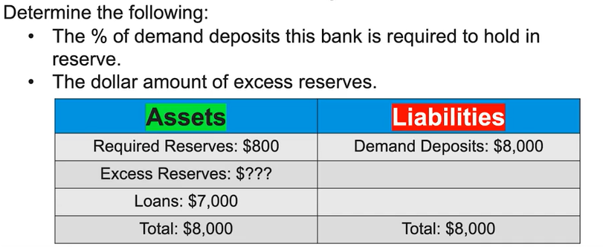
Reserve Requirement = 800/8000 = 10%
Excess Reserves = 8000 – 7000 – 800 = $200

Slide 31
Balance Sheet Changes
The balance sheet can change based on many things:
Eg. the amount that customers deposit

Slide 32
Balance Sheet Changes
Summary
Events can take place which will change the balance sheet.
We must keep the two sides balanced always.
Example – CUSTOMER WITHDRAWS 1000
Assets | Liabilities
Required Reserves (10%) 500 Excess Reserves 2000 Loans 2500 | Deposits 5000
Businesses are constantly making changes to their business and this will lead to changes in the balance sheet.
  Customer withdrawals - When customers withdraw money, it is withdrawn from a bank’s assets and liabilities.
  Customer deposits - When customers deposit more money, it is added to assets and liabilities.
  Changes to required reserves – the rules for required reserves can change.
  Changes to bank decisions – banks can also choose what they do with their money. Banks may choose to keep more excess reserve, or to lend out more money.
Assets | Liabilities
Required Reserves (10%) 500 – 100 = 400 Excess Reserves 2000 – 900 = 1100 Loans 2500 | Deposits 5000 – 1000 = 4000
Balancing Both Sides
When we make changes we have to ensure that the changes are balanced on both sides.
  The change will be balanced:
    Eg. We increase both sides by $1000
  The total balance will also be balanced:
    Eg. Assets and Liabilities both equal $50,000

Slide 33
Affects 1 side only
Summary
Both sides must always be balanced!
Therefore any change must affect both sides equally.
Affects 2 sides
+500
+125
-400
+375
+400
Eg. A customer increases deposits (liability) which also increases the required reserves and treasury bonds (asset)
Eg. The bank decides to decrease treasury bonds but increase loans

Slide 34
If a bank takes an additional $1000 deposit from a customer, what has happened to their:
  Assets?
  Liabilities?
  Bonus: Equity? (Equity = assets – liabilities)
Assets – increased by $1000
Liabilities – increased by $1000
Equity – For AP Macro we can assume equity is always zero, without the need to calculate Equity = Assets – Liabilities = 1000 – 1000 = 0

Slide 35
A bank reduces their excess reserves by $1000 and lends $1000 out to a business.
What has happened to their total assets?
Reserves have decreased by 1000 but loans have increased by 1000.
Therefore total assets is unchanged.
What has happened to their total liabilities?
Change on the asset side is zero. Therefore change on the liability side is also zero because both sides are balanced.

Slide 36
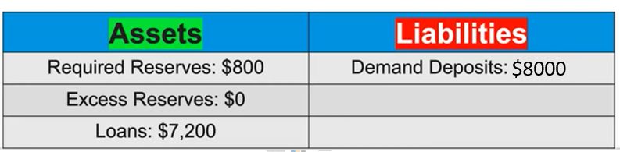
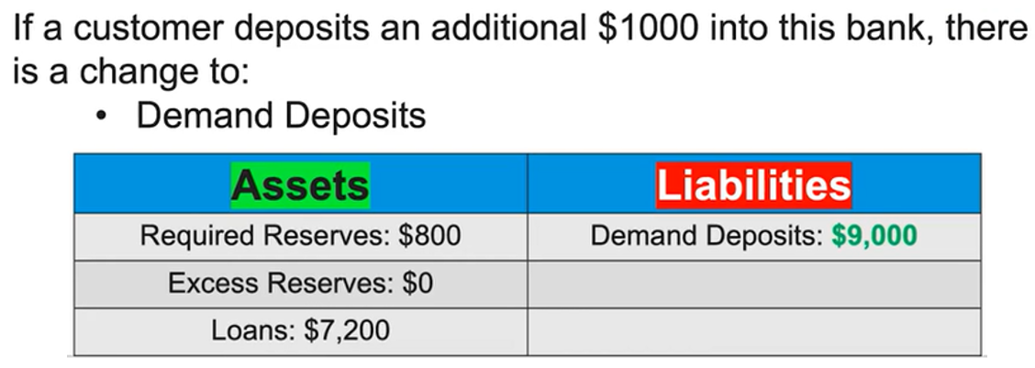
1
2
But both sides are not balanced.

Slide 37
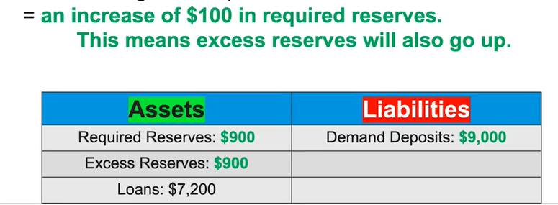
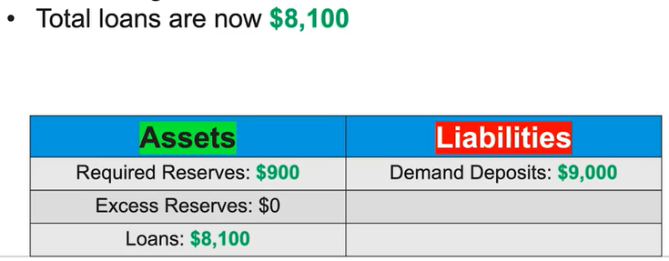
3
Assume now that the bank uses all excess reserves to create new loans.
4

Slide 38



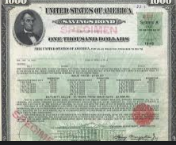

Changing Assets in a Particular Order
Summary
Required Reserves change first because of the law.
Loans change last because they’re contracts which are hard to break.
Banks can also borrow from other banks and the Federal Reserve so they have enough.
When we make changes to the balance sheet, we typically have an order of how we change the assets (if we need to increase or decrease certain assets).
If the bank does not have enough assets, then it can borrow from the Fed or from other banks.
If a customer takes out money from the bank, what order do we change the assets?
Reserves
  Required reserves first.
    This occurs because having the correct amount of required reserves is required by law.
  Excess Reserves
    This comes next because it is available liquid money that can be increased or decreased easily.
Other Assets eg. Bonds
  Bonds can be sold relatively easily, but will still come after the excess reserves which are cash.
The bank may also choose to borrow money from the Federal Reserve or other banks to make up the difference. Of course they will have to pay this back!
Loans last
  Loans are difficult to change because they are contracts between the bank and the borrower, so the bank will not want to cancel their loans.

Slide 39
If a customer takes money out of the bank (the liabilities decrease) then which asset account do we decrease first?
The required reserves
What is the last asset that banks will want to change if they need to change their assets?
Loans – this would involve breaking the loan contract.
  A bank that lends money then changes its mind, would you recommend this bank to others?
What can banks do if they do not have enough assets and have to pay back a liability?
They can borrow money from other banks.

Slide 40




Example – decreasing deposits
A customer takes out $2000 of the money they deposited in the bank.
Note: In this example the bank has no excess reserves! If customers take out their money they’ll have to find ways to get enough money to pay them back.

Slide 41
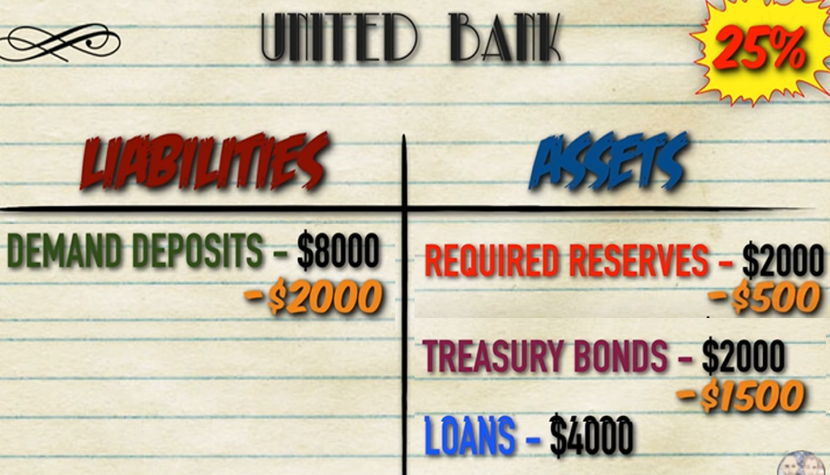
Example – decreasing deposits
A customer takes out $2000 of the money they deposited in the bank.
Original Balances
Changes have to be balanced on both sides after a decrease in Deposits of -$2000
Required Reserves:
  Demand deposits_{new} = 6000
  Required Reserves_{new} = 6000 x 0.25 = 1500
  Therefore Change = -$500
Treasury Bonds – this comes next because we don’t have any excess reserves and loans will be last.
  We have enough to cover the rest of the change
  Therefore Change = $-1500
Final Balances

Slide 42
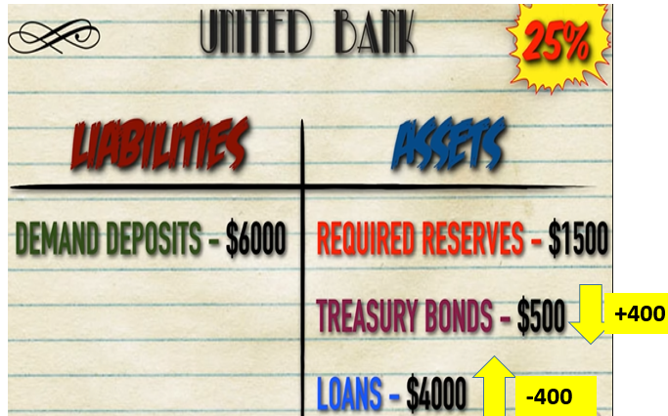
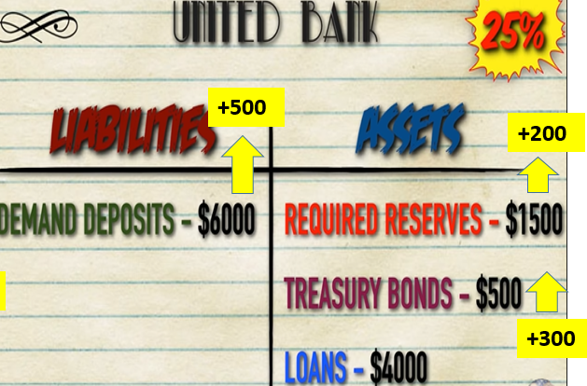
T Accounts Summary
Liabilities | Assets
Deposits | Required Reserves Excess Reserves Bonds Securities (securities is a generic word for a financial asset) Loans
We assume that banks have: assets and liabilities
Assets – things that have money value or can earn money in the future
  Loans – people will have to pay you back
  Required Reserves – the Fed will have to pay you back
  Excess Reserves – this is liquid money that the bank is just holding!
  Bonds – you will be paid back
Liabilities – things that will cost money in the future
  Deposits – this is money that the you must pay back to the customers
Assets = Liabilities (+Equity)
  Therefore both sides must be balanced.
Two sides are always balanced.
Therefore any change has to maintain the balance.
Affects 1 side of the T Account
Affects both sides of the T Account
Change of Liabilities/Assets
When we decrease liabilities side the money comes out of the assets in order:
Required reserves first.
Excess Reserves
Other assets (eg. Bonds)
bank can BORROW FROM OTHER BANKS
Loans

Slide 43
Assets | Liabilities
Required Reserves (10%) 1000 Excess Reserves 1000 Bonds 5000 Loans 3000 | Deposits 10000
Calculate the new T account after the deposits are decreased by 4000.

Slide 44
Assets | Liabilities
Required Reserves (10%) 1000 – 400 = 600 Excess Reserves 1000 – 1000 = 0 Bonds 5000 – 2600 = 2400 Loans 3000 | Deposits 10000 – 4000 = 6000
Note that the change is balanced: -400 -1000 - 2600 = -4000 Note that the final amounts are also balanced. 600 + 0 + 2400 + 3000 = 6000 = 6000
Calculate the new T account after the deposits are decreased by 4000.
Change = red
final amount = green

Slide 45
Exercises on Changing the Balance Sheet

Slide 46
How Can A Bank Increase Its Loans?
A lot of what we cover in Unit 4 is about how banks can create new loans.
We will see that a bank can make new loans from its excess reserves.

Slide 47
A customer wants a loan of $20,000…
How does the balance sheet change?
Assets |  | Liabilities
Loans | $900,000 | Deposits | $1,000,000
Reserves
 |  | Equity
 |  | 0
Required Reserves $50,000
Excess Reserves $50,000

Slide 48
A customer wants a loan of $20,000…
How does the balance sheet change?
Assets |  | Liabilities
Loans | $900,000 +$20,000 | Deposits | $1,000,000
Reserves
 |  | Equity
 |  | 0
Required Reserves $50,000
Excess Reserves $50,000 - $20,000

Slide 49
Additional Loans come from Excess Reserves
Assets |  | Liabilities
Loans | $900,000 | Deposits | $1,000,000
Reserves
 |  | Equity
 |  | 0
increase
Excess reserves is money that is available and not being used.
  Therefore, it has the potential to be used for new loans.
In many questions, it will ask ‘what is the amount this bank can increase its loans’.
  You should look at the excess loans. This is the amount that can potentially be loaned out.
Required Reserves $50,000
Excess Reserves $50,000
decrease
Excess reserves can potentially be made into new loans
Summary
Excess reserves is extra cash and so this can be immediately turned into new loans.

Slide 50
How can a bank increase the size of its loans?
It can use its excess reserves.
True or False? The bank can use its required reserves to make additional loans.
False. Only excess reserves are available to be used.

Slide 51
Assets | Liabilities
Required Reserves (10%) 500 Excess Reserves 2000 Loans 2500 | Deposits 5000
If a bank has the following balance sheet, what is the maximum amount that it can increase its loans?
A bank can only increase loans by the size of its excess reserves.
Therefore, $2000.

Slide 52
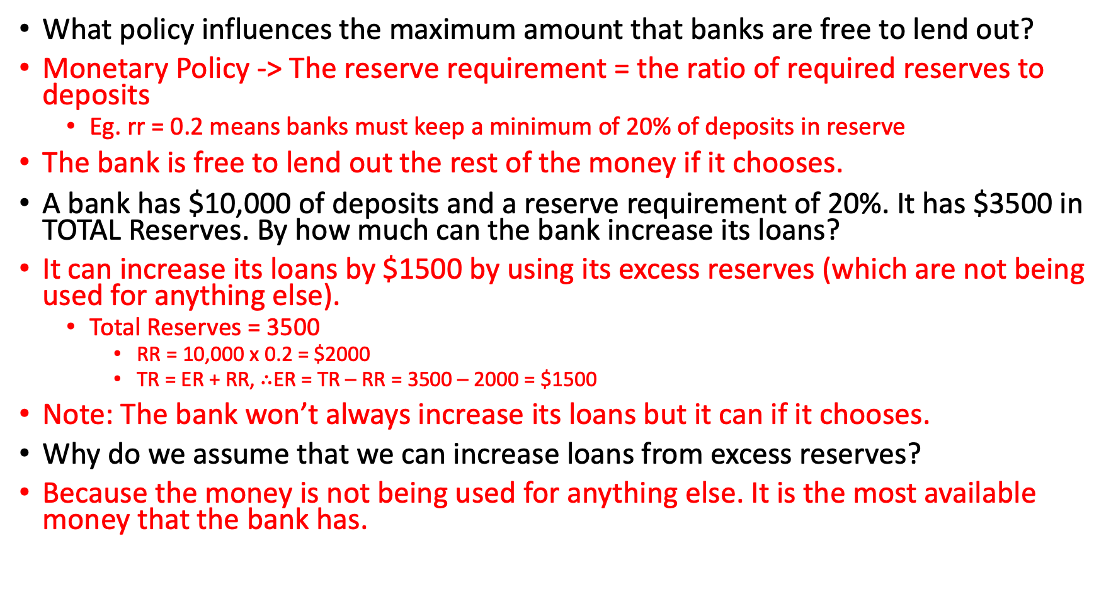
What policy influences the maximum amount that banks are free to lend out?
Monetary Policy -> The reserve requirement = the ratio of required reserves to deposits
  Eg. rr = 0.2 means banks must keep a minimum of 20% of deposits in reserve
The bank is free to lend out the rest of the money if it chooses.
A bank has $10,000 of deposits and a reserve requirement of 20%. It has $3500 in TOTAL Reserves. By how much can the bank increase its loans?
It can increase its loans by $1500 by using its excess reserves (which are not being used for anything else).
  Total Reserves = 3500
    RR = 10,000 x 0.2 = $2000
    TR = ER + RR, $∴$ER = TR – RR = 3500 – 2000 = $1500
Note: The bank won’t always increase its loans but it can if it chooses.
Why do we assume that we can increase loans from excess reserves?
Because the money is not being used for anything else. It is the most available money that the bank has.

Slide 53
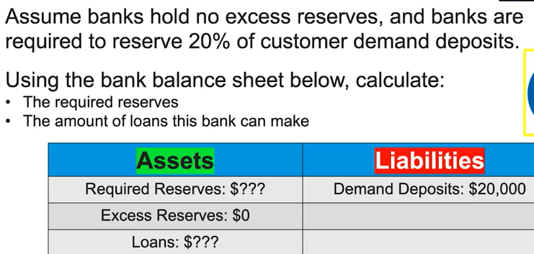
Required reserves = 20% x 20,000 = $4000
Everything above the required reserves, they could technically loan out, therefore loans = 20,000 – 4000 = 16000

Slide 54
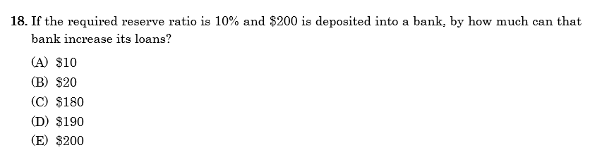
400 Macro Questions
Answer: C
We subtract what the bank must hold as required reserves. The rest is free to be lent.
200 – 200 x 0.1 = 180

Slide 55
Banks and the Money Supply

Slide 56
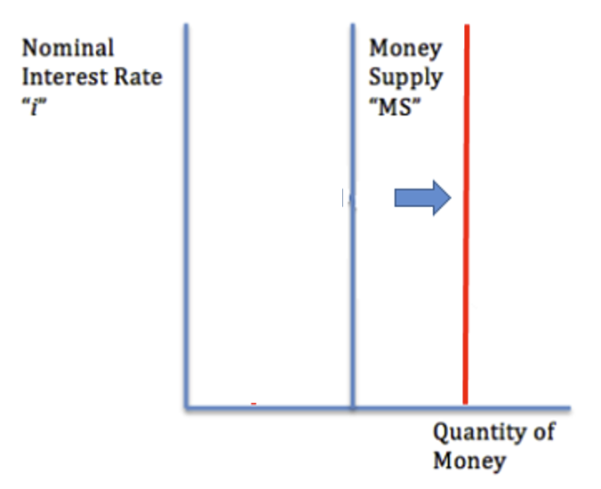

Deposits, banks and money supply
Your $100 deposit
Money supply increases by $70
Note: The money supply doesn’t change at first, because the money was already in the money supply.
Money supply increases by $49
Etc.
$70 loan to next bank
RR = 100 x 0.3 = $30
ER = $70
Banks can increase money supply by lending.
However, when you deposit money, usually it does not change money supply at first.
$49
loan to next bank
RR = 70 x 0.3 = $21
ER = $49

Slide 57
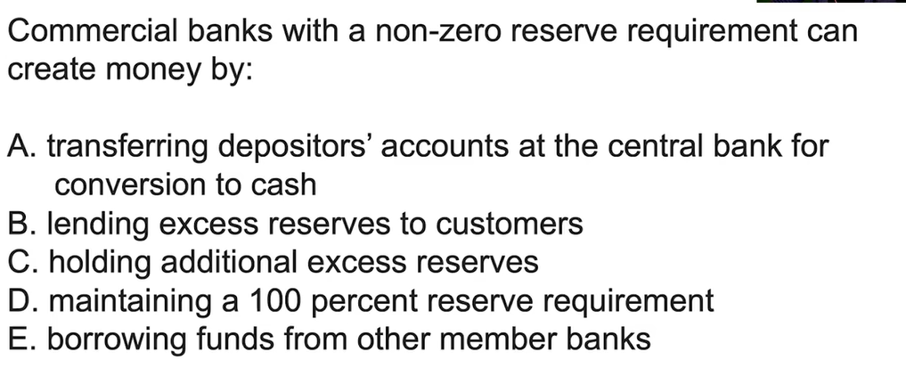
Answer: B

Slide 58
What effect do banks have on they money supply when they lend?
Increase MS
When you deposited $100 into a bank with a reserve ratio of 30%, how much did the money supply immediately change?
The $100 was already in the MS so the deposit itself causes no change.
What about when the bank takes your $100 and lends part of it?
When the bank lends it will increase MS.

Slide 59
Which of the following shows an increase of money supply?
  You deposit money in the bank.
  A bank lends money.
  A bank turns excess reserves into a loan.
No change. (Money was already in money supply)
Increase.
Increase.

Slide 60
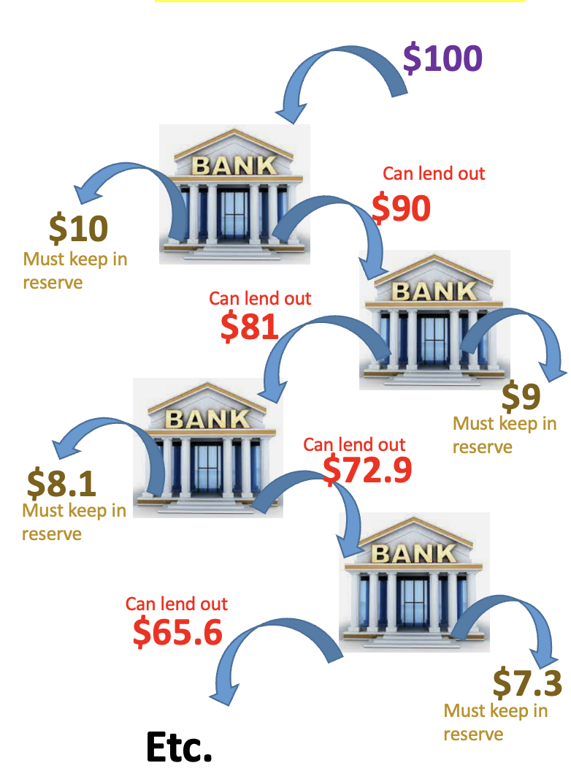

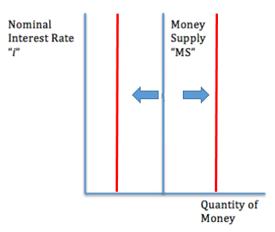
Bank System and Money Supply
Summary
As we covered previously, the central bank (Federal Reserve in the US) and commercial banks can increase and decrease MS.
We will lower the reserve requirement.
Now banks have more money available to lend, which will increase the MS.

Slide 61
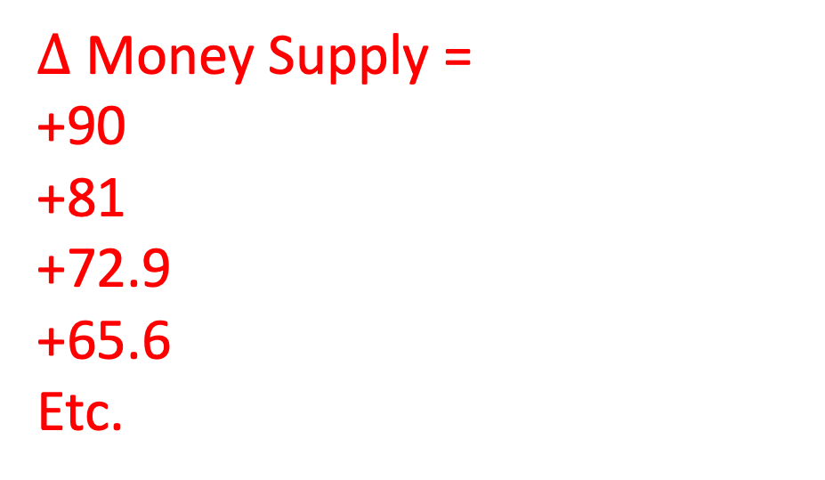
Banks Lending and Money Supply
(Assume banks must keep 10% of required reserves.)
When banks lend out money, they increase the money supply.
  We can see the effect on money supply as each bank lends.
When bank A lends, the money can end up in the next bank B, where it can be lended again, ending up in bank C etc.
$∆$Money Supply =
+90
+81
+72.9
+65.6
Etc.

Slide 62
Banks Lending and Money Supply
(Assume banks must keep 10% of required reserves.)
When banks lend out money, they increase the money supply.
  We can see the effect on money supply as each bank lends.
When bank A lends, the money can end up in the next bank B, where it can be lended again, ending up in bank C etc.
$∆$Money Supply =
+90
+81
+72.9
+65.6
Etc.
Summary
Each time a bank lends, we assume it increases the money supply.
This process can repeat as money lent from one bank goes to another bank.

Slide 63
If you deposit $1000 in a bank that has a reserve requirement of 20%, what is the maximum amount that bank on its own can change the money supply?
Required Reserves = $1000 x 0.2 = $200
Excess Reserves -> Loans = $800
Therefore, can increase the MS by $800
True or False. When a bank lends money and increases the money supply by an amount $X, this will probably be the final amount of the change of MS.
False. Because banks can lend to each other, one bank can take the money from another bank and lend it again and again and again.
Therefore the total change of MS will almost always be larger.

Slide 64
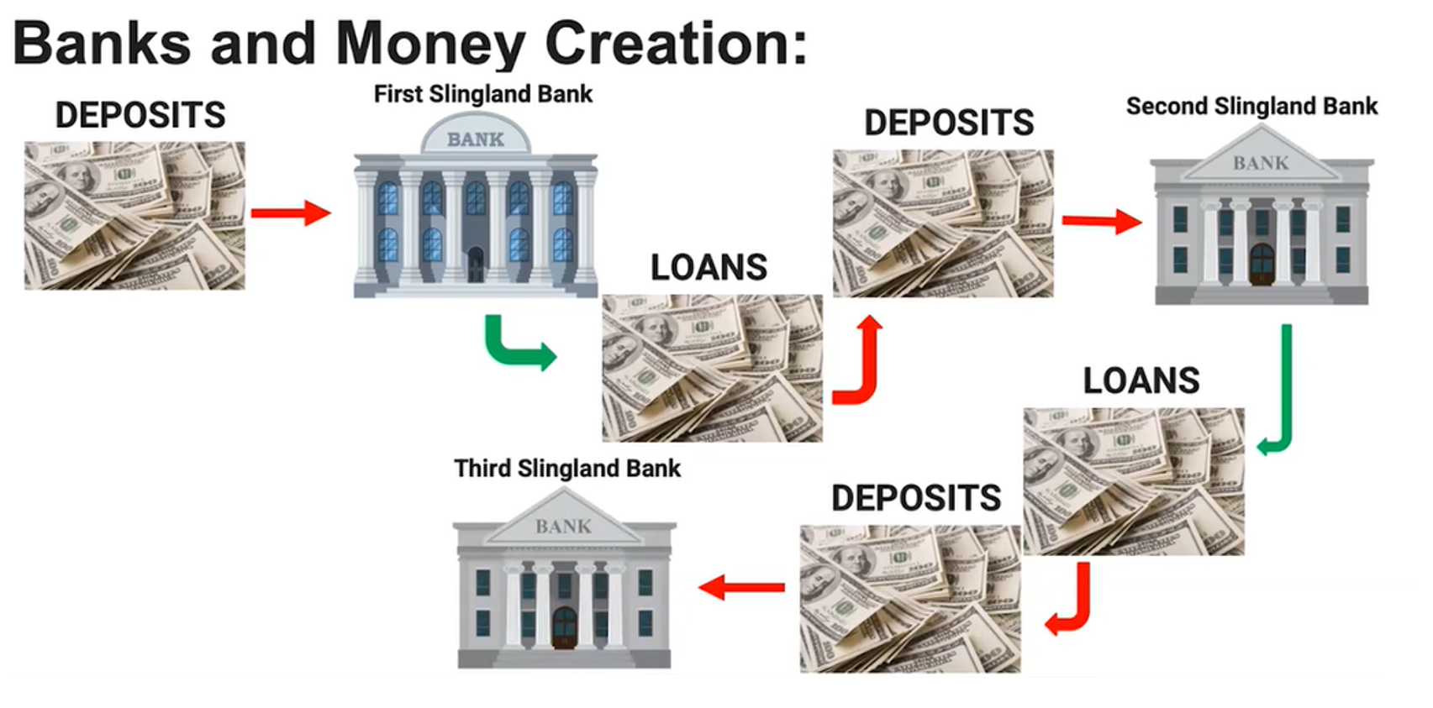
Another Example
Summary
Each time a bank lends, it increases the money supply and the total change will be larger than the first bank’s contribution.
The total effect on the money supply occurs when bank A lends to bank B and ban C etc.
Eg. $80
Eg. $100
Eg. $80
Eg. $55
When Bank A lends it becomes Bank B’s deposits,
then Bank B’s loans becomes Bank C’s deposits,
then Bank C’s loans become Bank D’s deposits etc.
The total change of money supply will be bigger than the first change of money supply.
Eg. $55

Slide 65
What happens to the loans from Bank A in terms of Bank B and Bank C?
Bank A’s loans eventually can become deposits of Bank B.
Then Bank B can loan this money which eventually can become deposits of bank C.
What’s the total effect on the money supply when Bank A lends to Bank B who lends to Bank C etc.? Is it bigger or smaller than the first loan?
Bigger

Slide 66
The Money Multiplier
In Unit 3 we covered the Spending Multiplier (=1/(1-MPC) which showed how spending increased total expenditure through the economy by more than the original spending.
In Unit 4 we will look at the Money Multiplier, which is mathematically similar. However the Money Multiplier shows instead how the supply of money is increased in the economy by the banks.

Slide 67
$100 deposit
Revision: Where can the banks get money from loans?
Answer: Excess Reserves.
This is money that is not being used that can be used for loans.
The Money Multiplier
Because the total amount of MS is bigger than the initial change, we can refer to this effect as the money multiplier.
Because the change of MS from each bank follows a consistent pattern ie. is a geometric sequence
  We can mathematically calculate the change of MS by adding up all the terms OR using a mathematical shortcut
$70 loan to next bank
Deposits = $100
RR = $30
ER = New Loans = ∆MS = $70
$49
loan to next bank
Deposits = $70
RR = $21
ER = New Loans = ∆MS = $49
$34.3
loan to next bank
$4.03
loan to next bank
$5.76
loan to next bank
Example
Let’s assume the Reserve Requirement is 30%. You deposit $100 in a bank.
Bank A:
When you deposit $100 in a bank, Bank A, the bank has to keep 30% as reserves = $30. The bank is then free to lend $70 out as loans.
Bank B:
If this money is lent to another bank, Bank B, they will have to keep 30% of this $70 = $21. But they can lend out the remaining $49.
Bank C:
If this money is lent to another bank, Bank C, they will have to keep 30% of this $49 = $14.7 But they can lend out the remaining $34.3.
Bank D:
If this money is lent to another bank, Bank D, they will have to keep 30% of this $34.3 = $10.3. But they can lend out the remaining $24.
Etc.
Deposits = $49
RR = $14.7
ER = New Loans = ∆MS = $34.3
$24
loan to next bank
$8.23
loan to next bank
$16.8
loan to next bank
$11.76
loan to next bank
Deposits = $34.3
RR = 10.3
ER = New Loans = ∆MS = $24
Etc.
Deposits = $24
Summary
The Money Multiplier (MM) = 1/RRR
We multiply this by the original loan to work out the total change to money supply.
The sum so far is 70 + 49 + 34.3 + 24 + 16.8 + 11.76 + 8.23 + 5.76 + 4.03 = 207.79
If we keep on going we will reach a limit of $233.

Slide 68
$100 deposit
Revision: Where can the banks get money from loans?
Answer: Excess Reserves.
This is money that is not being used that can be used for loans.
Calculating the Total Effect of a Geometric Series
In the geometric series, to find the total we effect, we find the first amount, then multiply by the multiplier.
  Note: We did this in Unit 3 when looking at changes to consumption and AD.
In this unit we are looking at the money multiplier, which is different to the spending multiplier from Unit 3.
$70 loan to next bank
Deposits = $100
RR = $30
ER = New Loans = ∆MS = $70
$49
loan to next bank
∆Total Money Supply = Initial Change x Money Multiplier
Deposits = $70
RR = $21
ER = New Loans = ∆MS = $49
$34.3
loan to next bank
= 70 x 1/0.3 = 233
Money Multiplier
=
1/rr
Deposits = $49
RR = $14.7
ER = New Loans = ∆MS = $34.3
$24
loan to next bank
Deposits = $34.3
RR = 10.3
ER = New Loans = ∆MS = $24
The sum so far is 70 + 49 + 34.3 + 24 + 16.8 + 11.76 + 8.23 + 5.76 + 4.03 = 207.79
But because we are multiplying by the same amount each time, it is a geometric series.
So we can use a mathematical formula.
Etc.
Deposits = $24
Summary
The Money Multiplier (MM) = 1/RRR
We multiply this by the initial change to work out the total change to money supply.

Slide 69
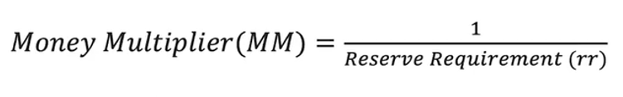
The Money Multiplier
The money multiplier is used to determine the maximum changes to the banking system when deposits or withdrawals of deposits happen.
If the central bank has a set rr of 10%, then:
Money Multiplier = 1/0.1
= 10
Change of Money Supply = Initial Change x MM
= Initial Change x 1/RRR

Slide 70
Bank System and Money Supply
Summary
As we covered previously, the central bank (Federal Reserve in the US) and commercial banks can increase and decrease MS.
We will lower the reserve requirement.
Now banks have more money available to lend, which will increase the MS.

Slide 71
Eg. If a bank loans out an additional $100, and the RRR = 10%, by how much will total money supply increase once it has gone through the whole financial system?
∆Money Supply = Loan_{original} x Money Multiplier
= 100 x 1/0.1 = $1000
What is the maximum amount that the MS will change if you deposit $100 in the bank with a RRR = 10%, once the bank and other banks lend out the maximum amount?
Total change to MS = initial change x money multiplier
= 90 x 1/0.1 = 900
How did we calculate the initial change to the MS?
See to the right.
(Initial Change)
$100 deposit
RR = 100 x 0.1 = $10
ER = $90
$90 maximum new loan

Slide 72
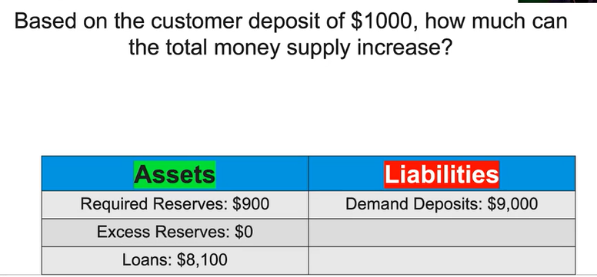
+100 = 1000
+1000 = 10,000
+900 = 900
The bank now has excess reserves of 900. The bank can lend this out as new loans.
The effect throughout the whole system = Initial change x 1/RRR
  Therefore money supply can increase money supply by 900 x 1/0.1 = 900 x 10 = 9000

Slide 73
Commercial banks with a non-zero reserve requirement can create money by:
  A Transferring depositor’s accounts at the central bank for conversion to cash.
  B Lending excess reserves to customers
  C Holding additional excess reserves
  D Maintaining a 100 percent reserve requirement
  E Borrowing funds from other member banks
Answer: B -> this is the only option that creates more money, most of the other options decrease it

Slide 74
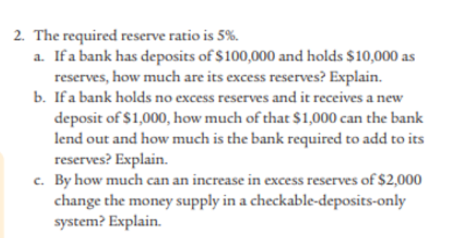
Mod 25
Answer:
A) 5000 excess reserves
B) it can lend out (1-0.05)x1000 = 950 dollars
C) if that money is lent out then the money supply could increase by 2000 x 1/0.05 = $40,000

Slide 75


Two Very Different Multipliers with Identical Maths
Summary
We have two geometric sequences in this course.
The maths is the same for both, even though what is measured is different.
We have looked at two geometric sequence situations in this course.
  The maths is the same but what they measure is very different
Total = Initial x Multiplier
  Unit 3: Spending Multiplier:
    Total Spending = Initial Spending x Spending Multiplier
  Unit 4: Money Multiplier:
    Total ∆Money Supply = Initial ∆MS x Money Multiplier
= Initial ∆Spending x 1/(1-MPC) or 1/MPS
Total Sum
of Spending in the economy
Total Sum of Money Supply
= Initial ∆MS x 1/RRR

Slide 76
What are the two multiplier effects that we study in AP Macroeconomics?
The spending multiplier in Unit 3
The money supply multiplier in Unit 4
What is a similarity between the two?
They are mathematically very similar because we are finding a shortcut for a geometric sequence.
True or False. They are mathematically similar to they must measure the same thing.
False, they DO NOT measure the same thing.
What is the difference between the two?
One is measuring change of money supply and the other measures the change of spending/AD in the economy.

Slide 77
Maximum Change of Money Supply vs Actual Change of Money Supply

Slide 78
Maximum Money Supply Created vs Actual
When we use the money multiplier formula we are calculating the maximum possible increase in money supply.
However, several things could make the money supplier smaller than the maximum.
  Banks keep excess reserves – banks will therefore not lend out the full amount possible
  Consumers may hold extra cash – consumers won’t typically deposit all the money they borrow, so the banking system won’t have as many deposits to lend out
  Low Demand for Loans – if no one wishes to borrow money then banks won’t be able to make loans
Maximum money supply change
Banks keep no excess reserves
Customers hold no extra cash
Complete demand for loans so banks have no extra money left over
Below Maximum money supply change
Initial Change in Loans
Banks keep excess reserves
Customers hold cash
Low demand for loans
Money Multiplier
1/RRR
Summary
The maximum money supply increase will likely be less because not all possible money will be loaned out for various reasons.

Slide 79
Maximum Loans/Deposits/Money Supply Change
Banks keep no excess reserves
Customers hold no extra cash
Complete demand for loans so banks have no extra money left over
Below Maximum Loans/Deposits/Money Supply change
Banks keep excess reserves
Customers hold cash
Low demand for loans
Initial Change in Loans/Deposits/Money Supply
Money Multiplier
1/RRR

Slide 80
$100 deposit
∆Total Money Supply (maximum) = Initial Change x Money Multiplier
$70 loan to next bank
$49
loan to next bank
$34.3
loan to next bank
= 70+49+34.3+24+ etc.
rr = 0.3
$24
loan to next bank
= 70 x 1/0.3 = 233
Deposits = $70
RR = $21
ER = New Loans = ∆MS = $49
Etc.
Deposits = $49
RR = $14.7
ER = New Loans = ∆MS = $34.3
Deposits = $34.3
RR = 10.3
ER = New Loans = ∆MS = $24
Deposits = $24
Maximum money supply created
$57 loan to next bank
$42
loan to next bank
$25
loan to next bank
Eg. Bank doesn’t lend out all its money
$17
loan to next bank
= 57+42+25+17+ etc.
= <233
Eg. Customers hold extra money instead of in bank
Summary
We use the money multiplier to calculate the maximum change of MS but there are several reasons why the real change would be less.
Eg. Fewer people want to take on loans
Etc.
Less than maximum money supply created

Slide 81
What is one reason why the actual increase in money supply from the banking system is smaller than the maximum increase in money supply?
Banks keep excess reserves
Customers hold cash and don’t deposit in banks
Banks may want to lend out money but there is no demand from borrowers

Slide 82
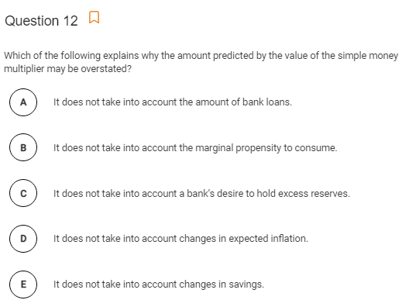
AP Prog Check
Answer: C
When the bank holds excess reserves, the maximum amount of money is not being lent out.
Therefore the multiplier will be smaller.

Slide 83

One Bank vs Banking System Questions
Summary
Take note if the question is about one bank or about the whole banking system.
Sometimes the question will simply be referring to one bank only.
In this case we don’t need to use the money multiplier.
Vs.

Slide 84
You deposit $100 in a bank. What is the maximum amount that the bank can increase its loans? Assume a RRR of 0.10
ER = $90, therefore loans = $90
You deposit $100 in a bank. What is the maximum amount that the banking system can increase its loans? Assume a RRR of 0.10
Total loans = 1st loan x MM = 90 x 1/0.1 = 900
If a bank decides to increase its loans by $50 what is the immediate effect on the money supply?
$50
If a bank decides to increase its loans by $50, what is the total effect on the money supply?
$50 x 1/0.1 = $500

Slide 85
Different Types of Money Multiplier Questions
Normal Money Supply Questions
Usually when customer deposits money in bank
Buying/Selling Bond questions
Happens when the government buys/sells bonds
Deposit Questions
Calculate the ∆ deposits in the bank system instead of the ∆ money supply
Reserves Questions
Calculate the ∆ reserves in the bank system instead of the ∆ money supply
The common thing about all of these is that they are geometric series!
a + ax + ax^2 + ax^3 + ax^4 + … + ax^n
Therefore, we can find the total sum by finding the first term and the multiplier
= a.1/(1-x), which in this case = a. 1/rr
The hardest part is working out what the first term should be!

Slide 86
Different Types of Money Multiplier Questions
Normal Money Supply Questions
Usually when customer deposits money in bank
Buying/Selling Bond questions
Happens when the government buys/sells bonds
Deposit Questions
Calculate the ∆ deposits in the bank system instead of the ∆ money supply
Reserves Questions
Calculate the ∆ reserves in the bank system instead of the ∆ money supply
Eg. You have $100 in cash and then your deposit it in the bank in a checking account which increases the deposits of the bank.
Then the banks start lending.
Eg. You have $100 in cash and then your deposit it in the bank in a checking account which increases the reserves of the bank.
Then the banks start lending which increases reserves in that bank as well.
Eg. You have $100 in cash (M1) and then your deposit it in the bank in a checking account (M1).
Then the banks start lending.
Eg. The central bank buys $1000 of bonds from a commercial bank. The money for the bonds enters the money supply and it wasn’t there before.
Then the banks start lending.

Slide 87
Normal Supply Questions
$100 deposit
When a customer deposits money in a bank.
$50
Initial Change to MS
Deposits = $100
RR = $50
ER = $50
∆MS = 50
$25
∆Money Supply = Initial Change x 1/RRR
=50 x 1/0.5 = 100
Deposits = $50
RR = $25
ER = $25
∆MS = 25
$12.5
Deposits = $25
RR = $12.5
ER = $12.5
∆MS = 12.5
$6.25
Deposits = $12.5
RR = $6.75
ER = $6.75
∆MS = 6.75
Etc.
Deposits = $6.25
Summary
The Money Multiplier (MM) = 1/RRR
We multiply this by the original loan to work out the total change to money supply.

Slide 88
If a customer deposits $500 in a bank which has a reserve requirement of 0.25, what is the total maximum change of money supply?
The first loan = 500 x 1-0.25 = 375
∆MS = first loan x 1/rr = 375 x 1/0.25 = 1500

Slide 89
Buying/Selling Bond Questions
$100 directly into Money Supply therefore, Initial change = 100
When government buys bonds.
$50
∆Money Supply = Money for bond x 1/RRR
= 100 x 1/0.5 = 200
Deposits = $100
RR = $50
ER = $50
∆MS = $100 + 50
$25
Deposits = $50
RR = $25
ER = $25
∆MS = 25
$12.5
Deposits = $25
RR = $12.5
ER = $12.5
∆MS = $12.5
$6.25
Deposits = $12.5
RR = $6.25
ER = $6.25
∆MS = $6.25
Etc.
Deposits = $6.25
Summary
The Money Multiplier (MM) = 1/RRR
We multiply this by the original loan to work out the total change to money supply.

Slide 90



Buying Bonds vs Selling Bonds
Summary
The Fed buying bonds will increase the monetary base first, then the money supply when banks start to loan.
Money that the Fed holds is not a part of the money supply.
So when the Fed buys they put new money in the money supply and when they sell they take money out of the money supply.
The Fed Buys Bonds
The Fed Sells Bonds
M1 & M2 Money Supply
M1 & M2 Money Supply
Bonds
Bonds
Bonds leave the system and money enters the money supply.
Therefore money supply increases.
Buy = Big
Bonds enter the system and money leaves the money supply.
Therefore money supply decreases.
Sell = Small
Note: The Monetary Base (MB) the first thing to increase when the Fed buys bonds. Once banks start lending, money supply will then increase.

Slide 91
If the reserve bank buys $50 million worth of bonds, what is the maximum effect on the money supply? Assume the reserve requirement = 0.2
The 50 million goes directly into the money supply
∆MS = money for bond x 1/rr = 50 million x 1/0.2 = 250 million

Slide 92
Deposit Questions
$100 deposit from customer, therefore initial amount is $100
When the question asks for the change of deposits instead of money supply
$50
Deposits = $100
RR = $50
ER = $50
∆Money Supply = ∆Loans = First Loan x 1/RRR
$25
∆Deposits = First Deposit x 1/RRR
= 100 x 1/0.5 = 200
Deposits = $50
RR = $50
ER = $50
$12.5
Deposits = $25
RR = $25
ER = $25
$6.25
Deposits = $12.5
RR = $12.5
ER = $12.5
Etc.
Deposits = $6.25
Summary
The Money Multiplier (MM) = 1/RRR
We multiply this by the original loan to work out the total change to money supply.

Slide 93
If a customer deposits $1000 in a bank, what is the total maximum increase in deposits in the banking system. Assume a rr of 0.1.
∆deposits = first deposit x 1/rr = 1000 x 1/0.1 = 10,000

Slide 94
Normal Supply Questions
$100 deposit
Change to total reserves when a customer deposits money in a bank.
$50
∆Money Supply = ∆Loans = First Loan x 1/RRR
Deposits = $100
RR = $50
ER = $50
∆MS = 50
$25
∆Reserves= Initial Change x 1/RRR
=50 x 1/0.5 = 100
Deposits = $50
RR = $25
ER = $25
∆MS = 25
$12.5
Deposits = $25
RR = $12.5
ER = $12.5
∆MS = 12.5
$6.25
Deposits = $12.5
RR = $6.75
ER = $6.75
∆MS = 6.75
Etc.
Deposits = $6.25
Summary
The Money Multiplier (MM) = 1/RRR
We multiply this by the original loan to work out the total change to money supply.

Slide 95
If a customer deposits $1000 in a bank, what is the total maximum increase in reserves in the banking system. Assume a rr of 0.1.
∆reserves = first increase to reserves x 1/rr
= (1000x0.1) x 1/0.1
= 100 x 1/0.1
= 1000

Slide 96
Same Numbers but Different Question
$50 million with a RRR of 0.2
Normal Money Supply Questions
Usually when customer deposits money in bank
Buying/Selling Bond questions
Happens when the government buys/sells bonds
Deposit Questions
Calculate the ∆ deposits in the bank system instead of the ∆ money supply
Reserves Questions
Calculate the ∆ reserves in the bank system instead of the ∆ money supply
∆MS = ∆Initial x Money Multiplier
Initial = 50 x (1-0.2) = 40
∆MS = 40 x 1/0.2 = 200
∆MS = ∆Initial x Money Multiplier
Initial = 50 because when gov buys bonds it uses money not in the MS
∆MS = 50 x 1/0.2 = 250
∆deposits = ∆Initial deposit x Money Multiplier
Initial = 50
∆Deposits = 50 x 1/0.2 = 250
∆reserves = ∆Initial reserve x Money Multiplier
Initial = 50 x 0.2 = 10
∆Reserves = 10 x 1/0.2 = 100

Slide 97
Explanation of Money NOT already in the money supply questions – The government buys and sells bonds

Slide 98
Buying Bonds vs Selling Bonds
Summary
The Fed buying bonds will increase the monetary base first, then the money supply when banks start to loan.
Money that the Fed holds is not a part of the money supply.
So when the Fed buys they put new money in the money supply and when they sell they take money out of the money supply.
The Fed Buys Bonds
The Fed Sells Bonds
M1 & M2 Money Supply
M1 & M2 Money Supply
Bonds
Bonds
Bonds leave the system and money enters the money supply.
Therefore money supply increases.
Buy = Big
Bonds enter the system and money leaves the money supply.
Therefore money supply decreases.
Sell = Small
Note: The Monetary Base (MB) the first thing to increase when the Fed buys bonds. Once banks start lending, money supply will then increase.

Slide 99
What is the effect on MS if the government sells bonds?
Sell = small, decreases the money supply.
What is the effect on the MS if a member of the public buys a government bond?
In this case the government is selling the bond, so it is also sell = small therefore decrease MS.

Slide 100
Buying Bonds – Increase Monetary Base THEN Money Supply Afterwards
Summary
Buying bonds increases the money money supply.
However, it increases the excess reserves first (monetary base) and then once the banks start lending it enters the money supply.
When the Fed buys bonds from the banks, the money supply will increase, however it occurs in a particular order.
  1. The money that the Fed uses to buy bonds will first go into the excess reserves of banks.
  Because reserves are not part of the money supply, only the monetary base increases at first.
  2. However, once the banks start to lend, the money supply will also increase.
M1 & M2 Money Supply
Monetary Base
Gov buys bonds
Reserves
Banks start lending to each other

Slide 101
If the government buys $1000 worth of bonds from a bank, what is the immediate effect on the monetary base?
Buy = Big.
The monetary base increases by $1000 because banks now have more excess reserves.
What then happens to the money supply if we assume that banks keep no excess reserves?
Money supply will increase once banks start to lend with each other using this new money.

Slide 102
Money Multiplier Summary
The maximum effect of the money multiplier will be less if:
  Consumers may hold extra cash – won’t have as many deposits to lend out
  Banks keep excess reserves – banks will therefore not lend out the full amount possible
  Low Demand for Loans – if no one wishes to borrow money then banks won’t be able to make loans
Reserves
Total Reserves = Required Reserves + Excess Reserves
Excess Reserves can be directly turned into loans. Many questions will assume you know this.
Required Reserves = Deposits x RRR
RRR = Required Reserve Ratio = Required Reserves / Deposits
The money multiplier is used to calculate maximum changes in the money supply and to deposits in the banking system.
Money Multiplier = 1/RRR
  This occurs because banks can lend to other banks which can lend the money again and again etc.
∆MS(maximum) = Initial Change x Money Multiplier
= Initial Change x 1/RRR
  ∆Bank Deposits (maximum) = Initial Deposit x Money Multiplier

Slide 103
Same Numbers but Different Question
$50 million with a RRR of 0.2
Normal Money Supply Questions
Usually when customer deposits money in bank
Buying/Selling Bond questions
Happens when the government buys/sells bonds
Deposit Questions
Calculate the ∆ deposits in the bank system instead of the ∆ money supply
Reserves Questions
Calculate the ∆ reserves in the bank system instead of the ∆ money supply
∆MS = ∆Initial x Money Multiplier
Initial = 50 x (1-0.2) = 40
∆MS = 40 x 1/0.2 = 200
∆MS = ∆Initial x Money Multiplier
Initial = 50 because when gov buys bonds it uses money not in the MS
∆MS = 50 x 1/0.2 = 250
∆deposits = ∆Initial deposit x Money Multiplier
Initial = 50
∆Deposits = 50 x 1/0.2 = 250
∆reservces = ∆Initial reserve x Money Multiplier
Initial = 50 x 0.2 = 10
∆Reserves = 10 x 1/0.2 = 100

Slide 104
Money Multiplier Practice Questions

Slide 105

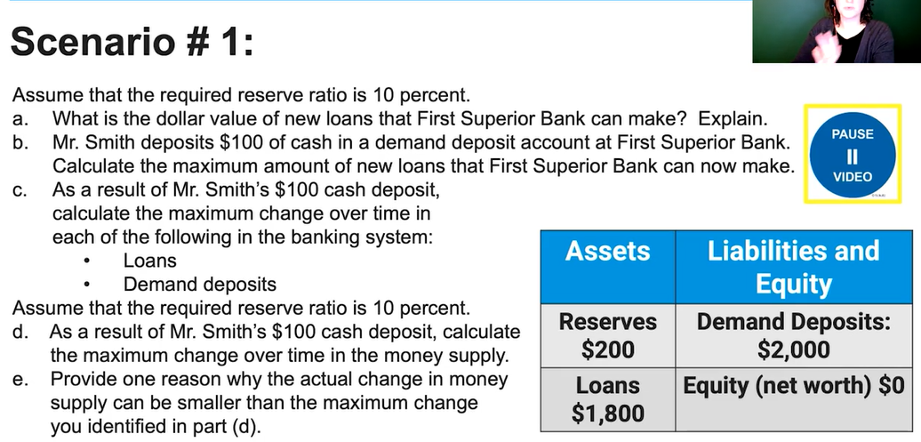

Slide 106
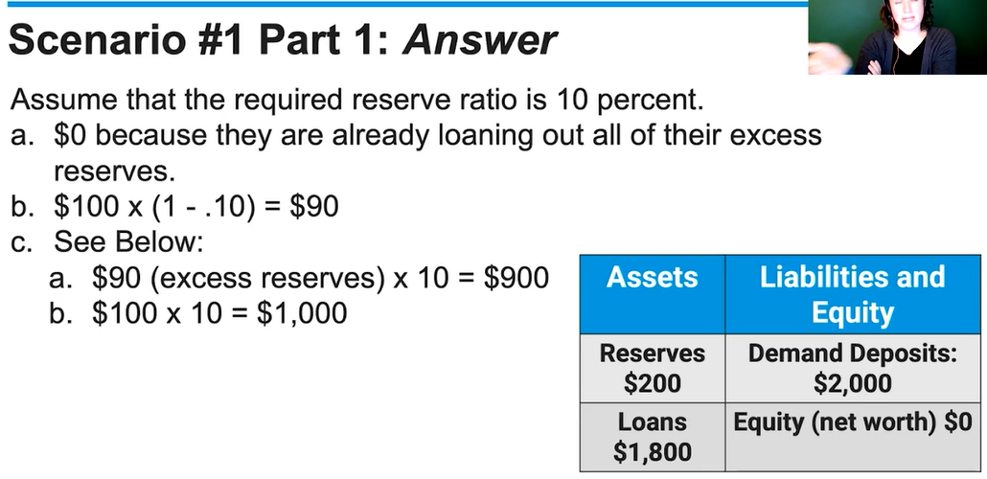

Slide 107
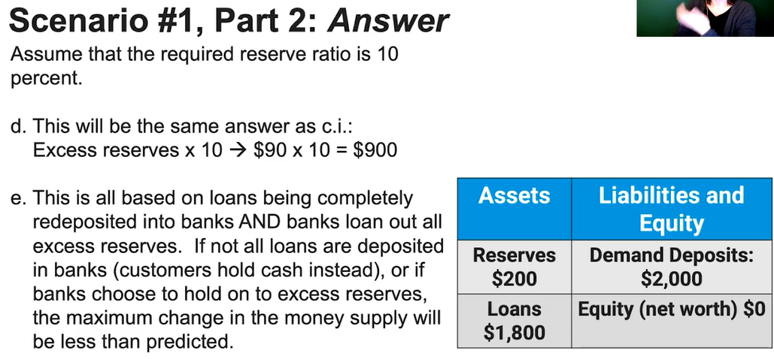

Slide 108
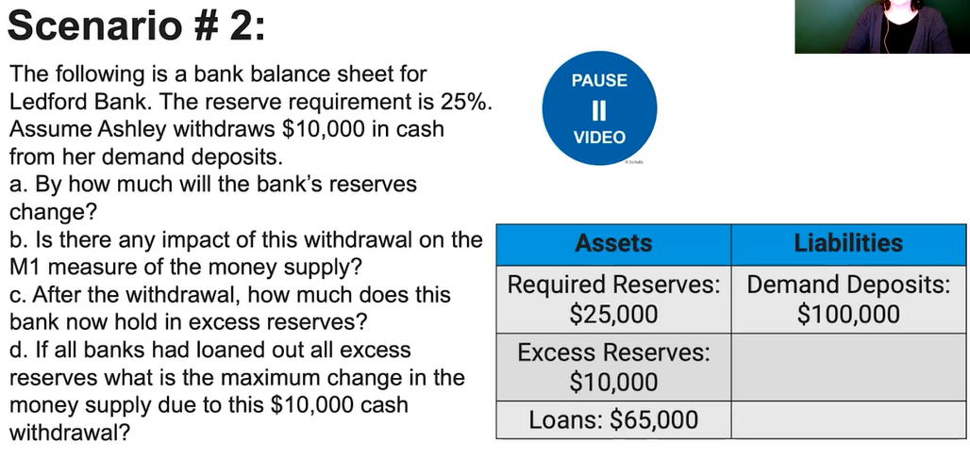

Slide 109
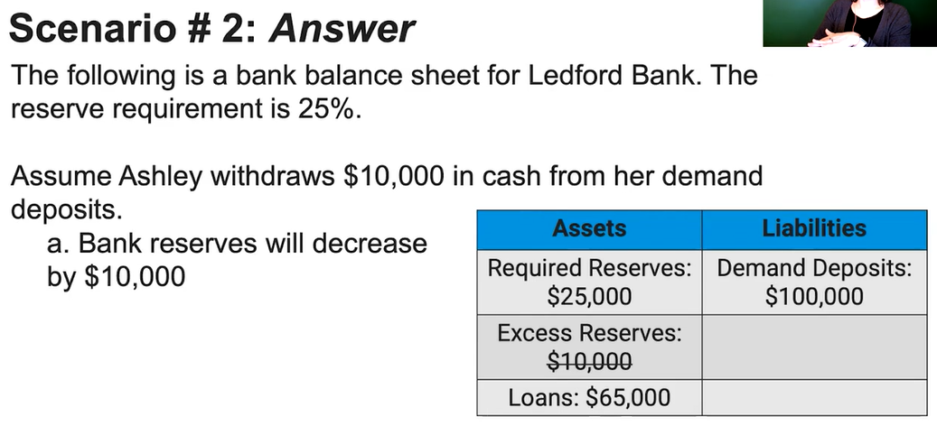

Slide 110
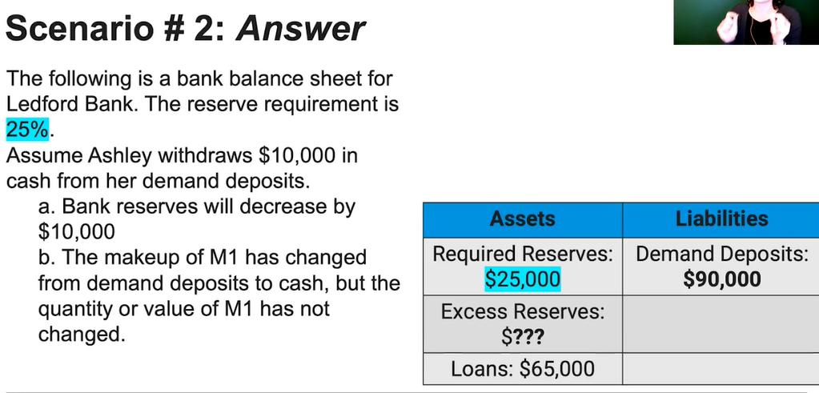

Slide 111
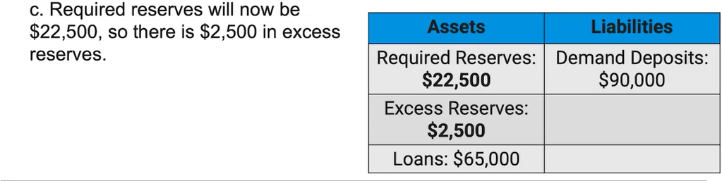

Slide 112
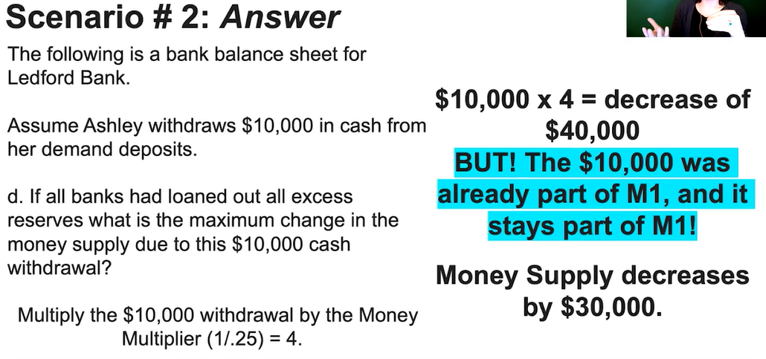

Slide 113
400 Macro Questions
19 If the required reserve ratio is 10 percent, what is the maximum change in demand deposits possible in the banking system if Denise deposits $25 into her checking account?
  $10
  $25
  $50
  $250
  $400
Answer: D
∆ Deposits = Deposit_{original} x 1/RRR
= 25 x 1/0.1 = 25 x 10 = $250

Slide 114
400 Macro Questions
20 What action must a bank take to create money?
  Lend excess reserves to customers
  Print currency at the Federal Reserve
  Keep all deposits in reserve
  Use all deposits to purchase stocks and bonds
  Purchase Treasury bills from the government
Answer: A
Remember that in most questions, the answer to ‘how can banks increase loans’ is ‘to use excess reserves.’

Slide 115
400 Macro Questions
21. If the reserve requirement is 20 percent, then $50 worth of excess reserves in the banking system can lead to a maximum expansion of the money supply equal to
  $20
  $50
  $100
  $250
  $500
Answer: D
This money in excess reserves will be lent out.
∆ Money Supply = Original Loan x 1/RRR
= 50 x 1/0.2 = 250

Slide 116
400 Macro Questions
22. If the public increases its desire to hold money as currency, what will the effect on the banking system?
  Banks would be more able to control interest rates.
  Banks would be less able to control interest rates.
  Banks would be more able to expand credit.
  Banks would be less able to expand credit.
  Banks would be more able to increase reserves.
Answer: D
Banks will not be able to lend out as much, decreasing the size of the money multiplier.

Slide 117
400 Macro Questions
Answer: D
Required reserves = $200 x 0.2 = $40
Total Reserves = Required reserves + Excess Reserves
At first, all the money that isn’t in required reserves goes into excess reserves. Therefore Excess reserves = 200 – 40 = 160
23 A bank with no excess reserves receives a $200 deposit from a new customer. If the required reserve ratio is 20 percent, this bank now has excess reserves equal to
  $20
  $40
  $80
  $160
  $200

Slide 118
400 Macro Questions
24 A bank with no excess reserves receives a $10,000 cash deposit from a new customer. If the required reserve ratio is 20 percent, what is the maximum amount by which this bank may increase its loans?
  $2,000
  $8,000
  $10,000
  $20,000
  $40,000
Answer: B
The bank must keep 0.20 x 10K = 2K as required reserves.
The rest can be lent out = 10K – 2K = 8K

Slide 119
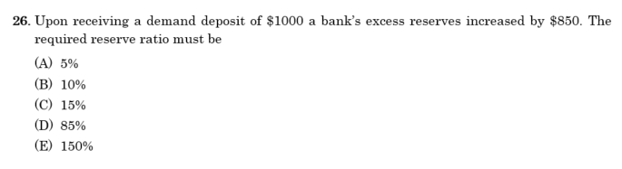
Answer: C
RRR = required reserves / deposits
= 150 / 1000 = 15%

Slide 120
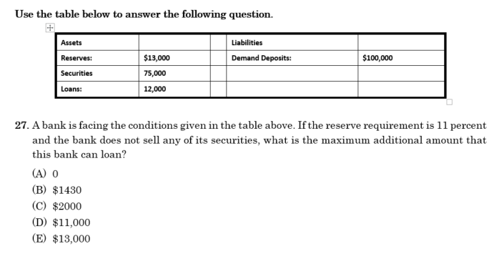
Total Reserves = Required Reserves + Excess Reserves
13K = 11K + Excess Reserves, Excess reserves = $2000
Therefore the bank can (without selling any of its securities) use these excess loans to increase loans.
Answer: C

Slide 121
28. If the reserve requirement is 10 percent but banks voluntarily keep some excess reserves, a $5,000 increase in new reserves will result in
  an increase in the money supply of $5,000
  an increase in the money supply of $50,000
  an increase in the money supply of less than $50,000
  a decrease in the money supply of $50,000
  a decrease in the money supply of more than $50,000
Answer: C
Remember that the new reserves (excess reserves) =$5000 will be used to make loans.
Therefore we use the formula: ∆Money Supply(maximum) = change of loans = Original Loan x Money Multiplier
= 5000 x 1/0.1 = 50,000
However if the bank holds excess reserves, not all of this will be loaned out. Therefore the actual change in money supply < 50K

Slide 122
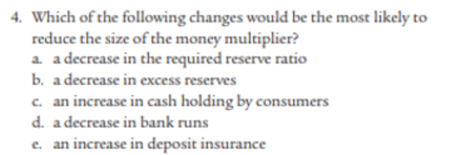
Mod 25
Answer: c
If people hold more cash then banks are not able to lend out as much money which would grow the money supply.

Slide 123
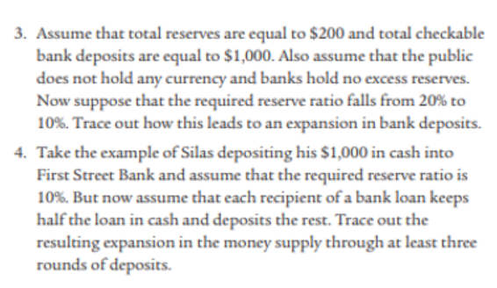
Mod 25
3. Banks now have to hold fewer reserves, so they can lend more money out to other banks which increases total deposits and money supply.
The Money Multiplier will also increase.
4.
Round 1 – Silas Deposits
Bank A keeps 10% = 100, lends out 90% = 900
Round 2
Person receives $900 loan. They keep $450 in cash. They deposit $450 in the bank B.
Round 3
Bank B receives the $450 and keeps $45. They lend out $405.

Slide 124
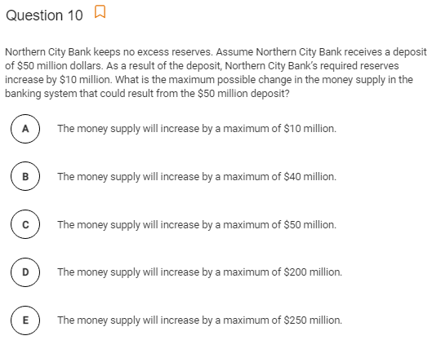
AP Prog Check
Answer: D
The original $50 million dollars was already in the money supply. Therefore the increase in money supply will just be a result of the increase in loans.
Step 1: Size of Original loan (subtract the required reserves)
Original loan = 50 million x (1-0.2)
= $40 million
Step 2: ∆Money Supply(maximum) = Original Loan x Money Multiplier
= $40 million x 1/0.2 = $200 million

Slide 125
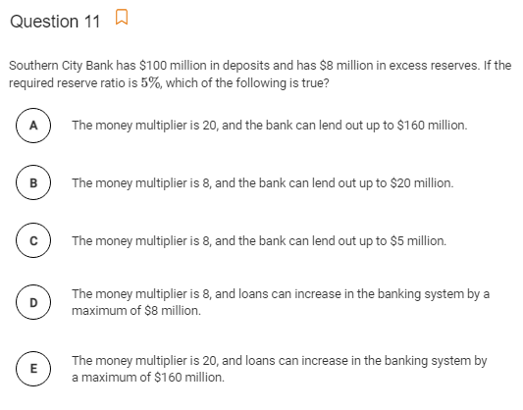
AP Prog Check
Answer:
Money multiplier = 1/0.05 = 20
Therefore it is A or E.
A can’t be true because they can’t lend out 160 million because they only have 8 million in excess reserves.
E is correct because by lending out the excess reserves that they have they can create a multiplier of 8 x 1/0.05 = 8 x 20 = 160 million
Therefore E

Slide 126
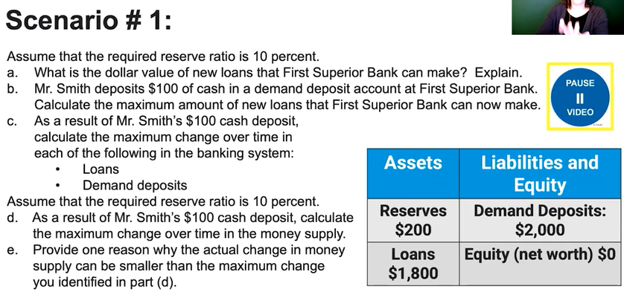

a) 0, they have no excess reserves to lend out.
b) 100 -> 10 RR , 90 ER. Therefore bank can lend out 90 maximum.
c) loans in the system can change by 90 x 1/RR = 900
Deposits in system can change by 100 + 90 x 1/RR = 100 + 900 = 1000
d) change in money supply = change in loans only (because money was already in the money supply) = 900
e) banks may keep excess reserves, people may not want to borrow the money available to be borrowed, customers may hold excess cash and not deposit it in a bank

Slide 127
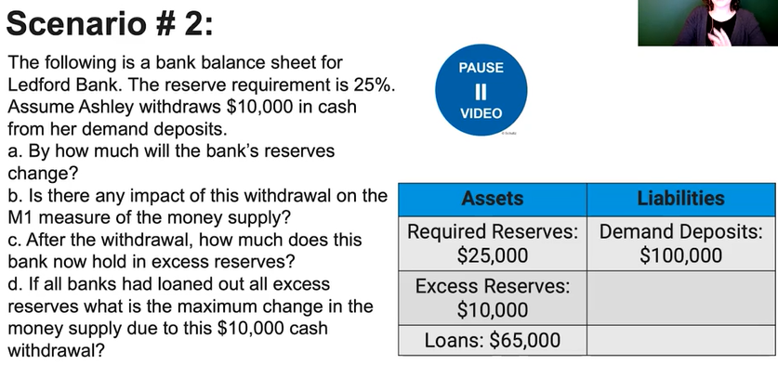
a) RR changes by -10,000 x 0.25 = -2500
ER changes by -7500 (to balance the equation, the change of assets must be -10,000 in total)
Therefore total reserve change = -10,000
b) 0, demand deposits and cash are both in M1
c) Bank holds 10,000 – 7500 = 2500
d) 7500 would have been loaned, total change in loans = change in MS = -7500 x 1/0.25 = -30,000

